Slide 1
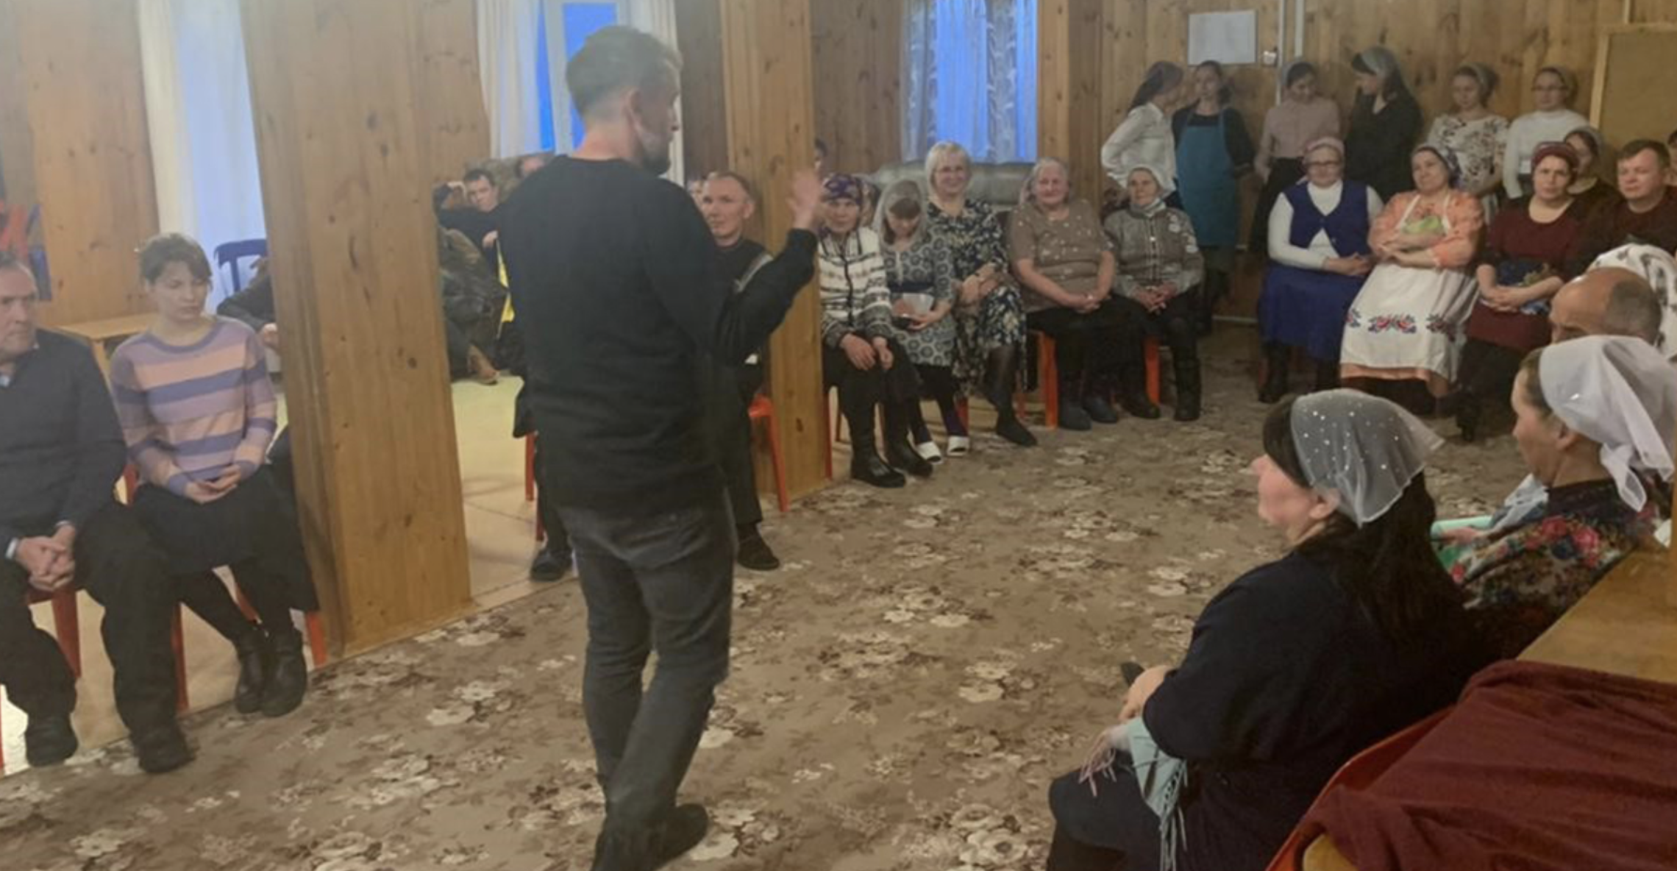
Refinement and Revision

Slide 2

After the 8 Steps of MAST
Feedback from other
Christians in the
language community

Slide 3

Refinement
better!
even
good
what is
Making

Slide 4
?
Affirming
work
New
eyes
Why include
others?
Wider acceptance
Spreading
the word
Ecclesiastes 4:9⎼12

Slide 5

Resources for Refinement
The Reviewers’ Guide
covers passages in each Bible book.
It confirms that even difficult passages are clear and complete.

Slide 6
Using the Reviewers’ Guide
A translator or another leader should guide the review. 2 to 4 community believers should review each passage.
Remember: Questions are designed to check the clarity and completeness of the translation, not to test the reviewers.
The leader reads background information and then a passage of translated Scripture.
The leader asks reviewers to summarize the passage. Then follow-up questions are asked.
All comments go back to the translation team for review. (Reviewers do not make any changes!)

Slide 7
Try it

Slide 8
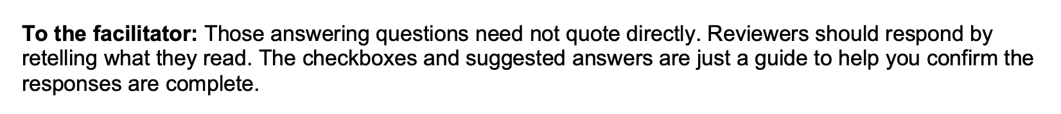
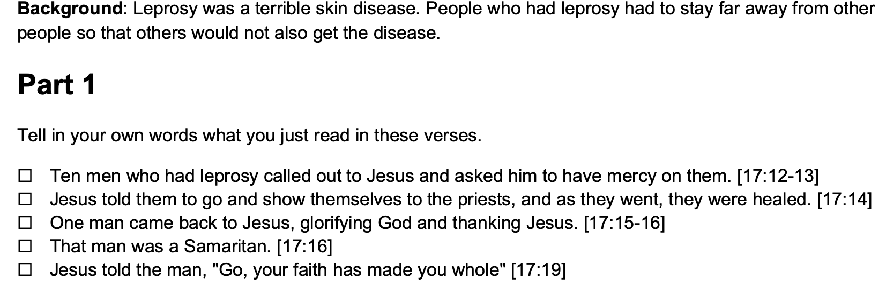
Luke 17:11–19

Slide 9
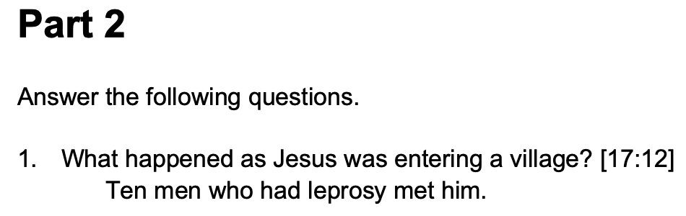
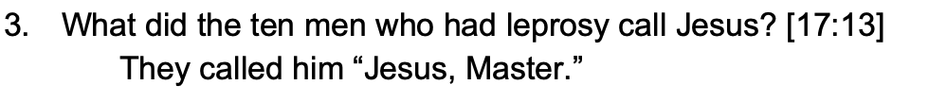
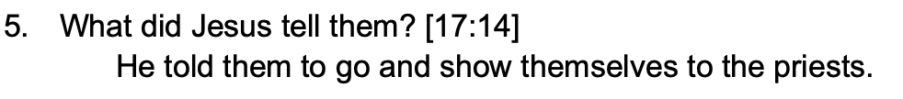
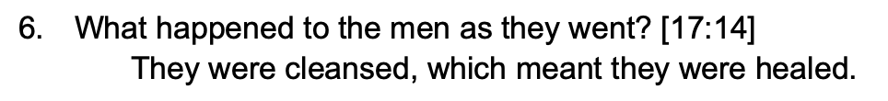


Slide 10
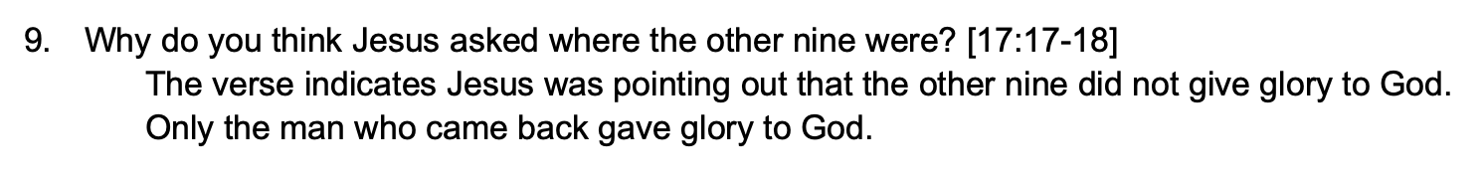
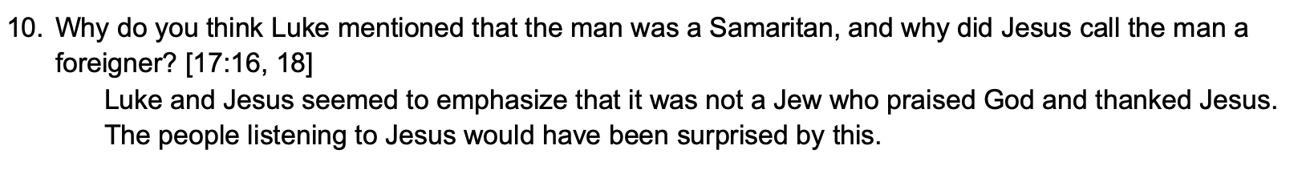

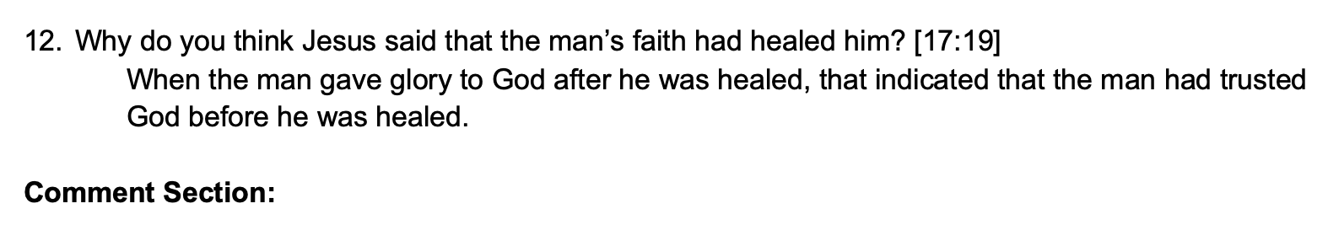

Slide 11
?
What response would you get?

Slide 12


